Slide 1
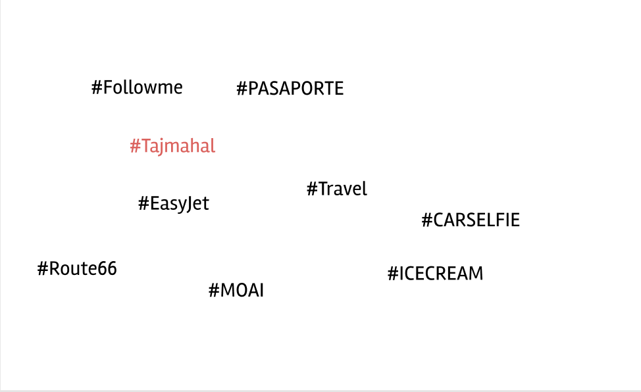
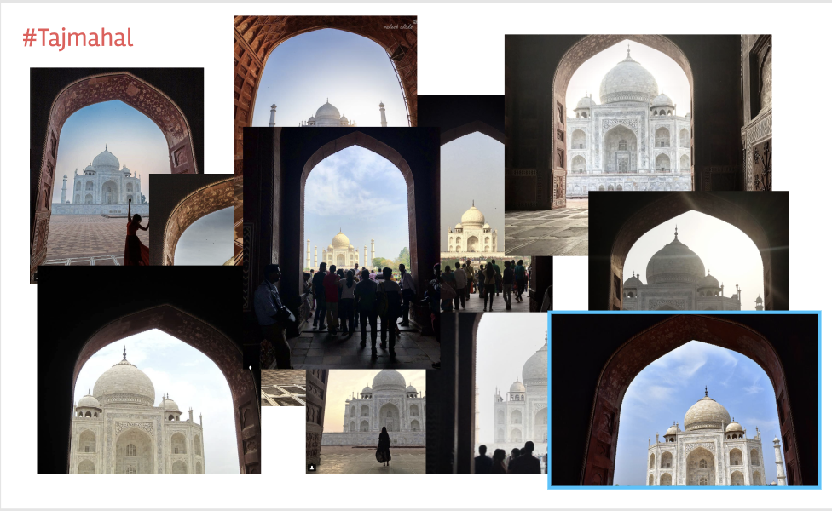
Idea 1
#PASAPORTE
#EASTJET
#FOLLOWMETOO
#PISA
#FONTANADITREVI
#MONALISA #TOUREIFFEL
#EMPIRESTATE
#ROUTE66
#UTAH
#CARSELFIE
#MACHUPICHU
#RIODIJINERO
#MOAI
#TAJMAHAL
#MOUNTFUJI
#RAMEN

